Slide 1

INTERNSHIP REPORT PRESENTATION
-By Vedang Gupta (21BCG10122)

Slide 2

I did my internship with Hindireadings.com, which is a blogging website that specializes in tutorials and Hindi Folk Stories

Slide 3

DOMAIN AND RESPONSIBILITIES
Domain: Frontend Architecture & UI/UX Design
Migration of the website from WordPress to Next.js.
Creating comprehensive website architecture diagrams
Developing Figma prototypes to streamline the migration process.

Slide 4

CHALLENGES FACED
I faced 3 main challenges during this internship:
Dealing with WordPress issues.
Creating a site architecture diagram that would be easy to navigate, while at the same time not being too jarring.
Learning and developing designs on Figma.

Slide 5

WORDPRESS ISSUES
What is WordPress? WordPress is a free and open-source content management system (CMS) that allows users to create and manage websites and blogs.
Since WordPress is open source, it has many plugins that are made by the community and navigating which version of which plugin is being used in the website is extremely difficult at times without any version control system in place.

Slide 6

SITE ARCHITECTURE CHALLENGES
Website Architecture is the most important part of any frontend design. How easy the website will be to navigate depends heavily on the site’s architecture.
Balancing simplicity of design for SEO, while also simultaneously maximizing internal links to reinforce the website’s architecture was the hardest part of this programme.

Slide 7
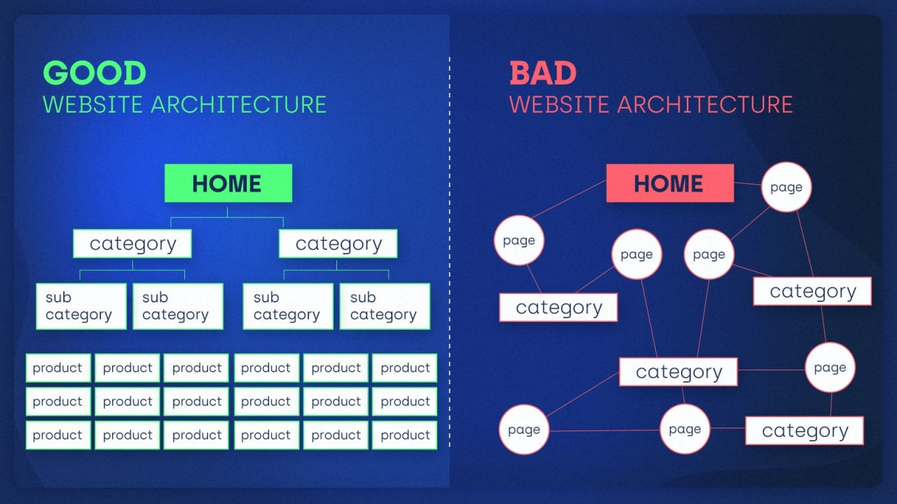

Slide 8

LEARNING FIGMA
Figma is a cloud-based design tool that allows users to create, share, and test designs for digital products.
It is the industry standard for designing websites and web-apps.
All in all, learning to design the frontend of a website on Figma was the most fun part of this internship programme.

Slide 9
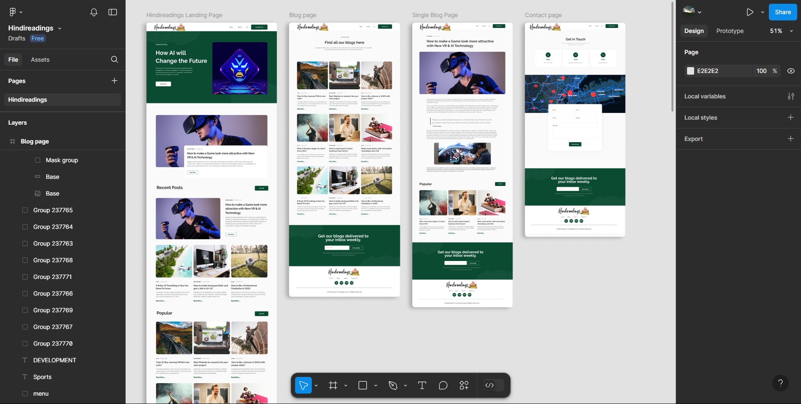
FIGMA DESIGNS CREATED DURING INTERNSHIP

Slide 10
Thank You

